Slide 1


Slide 2
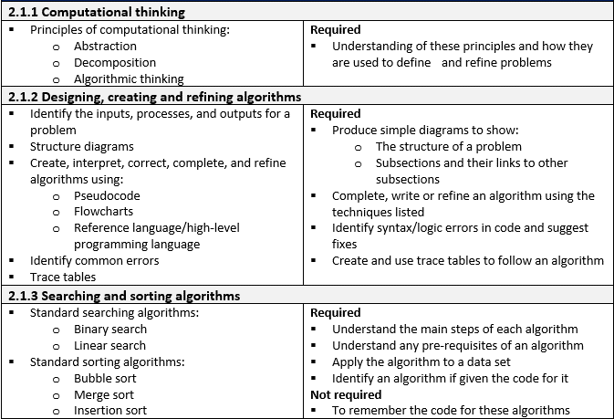
What will we learn in Unit 2.1?

Slide 3

What is an Algorithm?
An algorithm is a step by step set of instructions for solving problems. The order in which you carry out the steps in this process is very important.
This Photo by Unknown Author is licensed under CC BY-SA

Slide 4
Who Uses Algorithms?
Search engines e.g. Google
Financial services e.g. Buying and selling shares
Game makers e.g. GTA
School timetabling e.g. SIMS
Self driving cars
Apps e.g. Instagram
Chefs – e.g. Recipes
Doctors e.g. Making a diagnosis

Slide 5
Algorithm for cleaning teeth
Here is a simple algorithm for cleaning your teeth. We know it is an algorithm because it is a series of steps used to solve a problem.
Can this algorithm be improved?
Go to bathroom
Pickup toothbrush
Pickup toothpaste
Put toothpaste on tooth brush
Put toothbrush in mouth
Put toothpaste down
Clean teeth
Take toothbrush out of mouth
Put toothbrush down
Leave bathroom

Slide 6
Algorithm for cleaning teeth
One step shown is “Clean teeth”.
Could we develop our algorithm by including more steps to show what happens when you are actually cleaning your teeth?
Go to bathroom
Pickup toothbrush
Pickup toothpaste
Put toothpaste on tooth brush
Put toothbrush in mouth
Put toothpaste down
Clean teeth
Take toothbrush out of mouth
Put toothbrush down
Leave bathroom
What steps do you take when you are cleaning your teeth?

Slide 7
Algorithm for cleaning teeth
Breaking down one step in an algorithm into many steps is an example of decomposition.
Go to bathroom
Pickup toothbrush
Pickup toothpaste
Put toothpaste on tooth brush
Put toothbrush in mouth
Put toothpaste down
Clean teeth
Take toothbrush out of mouth
Put toothbrush down
Leave bathroom
Move brush at an angle of 90 degrees (in relation to the surface of the tooth) to the bottom right tooth (back molar)
Move the brush in a circular motion against the tooth (circles of radius 0.4 cm)
After 3 seconds move the brush one tooth along towards the centre of the mouth. (repeat this until you reach the bottom left molar tooth)
Move brush at an angle of 90 degrees (in relation to the surface of the tooth) to the top right tooth (back molar)

Slide 8
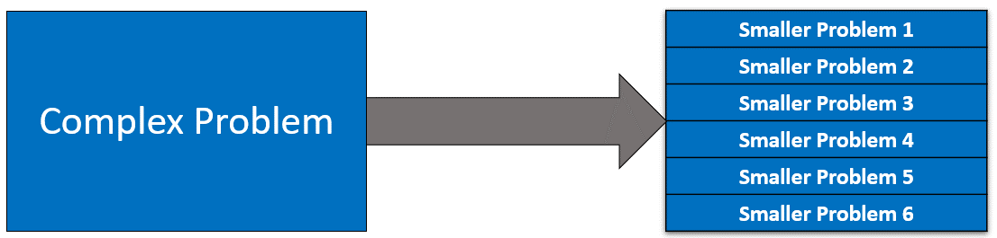
Principles of Computational Thinking
Decomposition
Decomposition consists of breaking down a complex problem into smaller problems that are more manageable and easier to understand. The smaller problems can then be solved more easily as they are simpler to work with.

Slide 9
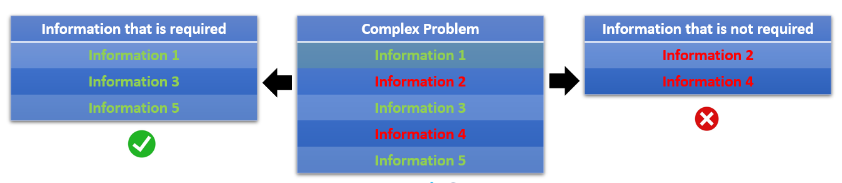
Principles of Computational Thinking
Abstraction
Complex problems contain a lot of detail, and not all of this detail is relevant, in terms of solving the problem. Focussing on information that is relevant to solving the problem and filtering out information that we do not require is called abstraction.

Slide 10
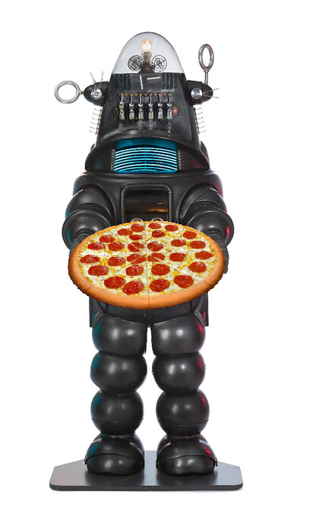
Principles of Computational Thinking
Algorithmic Thinking
Algorithmic thinking means adopting a step by step approach to solving complex problems. It is crucial that these steps are followed carefully and in a logical order. Algorithmic thinking is essential if you are going to write an algorithm that solves a problem.
For example, if you program a robot to make a pizza, but you forget to include the step that involves heating the pizza in an oven, then the robot may have made a pizza, but would you eat it?

Slide 11
CHECKPOINT
What is an algorithm?
In computer science, what is meant by decomposition?
In computer science, what is meant by abstraction?
What is meant by algorithmic thinking?

Slide 12
CHECKPOINT
What is an algorithm?
An algorithm is a step by step set of instructions for solving problems. The order in which you carry out the steps in this process is very important.
2. In computer science, what is meant by decomposition?
Decomposition consists of breaking down a complex problem into smaller problems that are more manageable and easier to understand.
3. In computer science, what is meant by abstraction?
Focussing on information that is relevant to solving the problem and filtering out information that we do not require is called abstraction.
4. What is meant by algorithmic thinking?
Algorithmic thinking means adopting a step by step approach to solving complex problems.

Slide 13
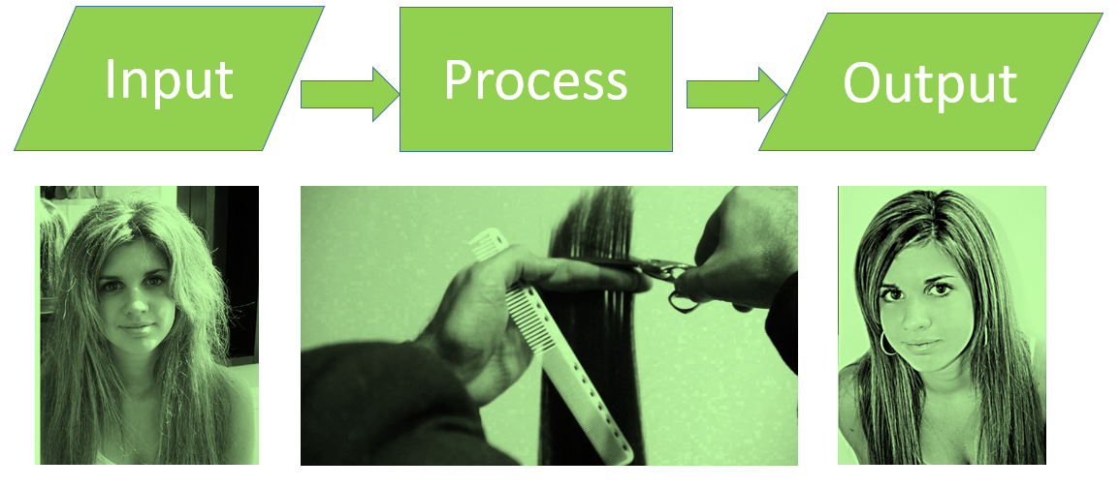
Input – Process - Output

Slide 14
Designing and Creating an Algorithm: Input
When a problem that you want to solve is complicated, it’s hard to know how, or where, to get started. A good starting point is to make use of decomposition and abstraction to give you a clearer idea of what the problem consists of.
The next stage is to identify the inputs – What information do you need to feed into your algorithm.
E.g. If your algorithm is going to find the square of a number, you’re going to need to know the number.
x=int(input(“What is your number”))

Slide 15
Designing and Creating an Algorithm: Process
The next stage is to Identify the process – What will your program do when it receives an input?
E.g. In the case of the algorithm mentioned on the previous slide, the process is to square the input number.
y=x^2
or in Python
y=x**2

Slide 16
Designing and Creating an Algorithm: Output
The next stage is to Identify the output – What will your program do when it processes the input, what will the output be?
E.g. In the case of the algorithm mentioned on the previous slide, the process of squaring the input number would be to produce an output number.
For example if x=4 then 4² = 16

Slide 17
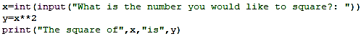
Designing and Creating an Algorithm
Input
Process
Output

Slide 18
Structure Diagrams
A structure diagram is used to help understand what is required to solve a problem.
The diagram includes the decomposed sub-sections of the problem and how these sub-sections are linked, especially in relation to input, process, output.
If you are going to produce a structure diagram start by thinking:
What information will I need (Input).
What will my algorithm do with this information?(Process).
What will I do with this information once it has been processed? (Output)

Slide 19
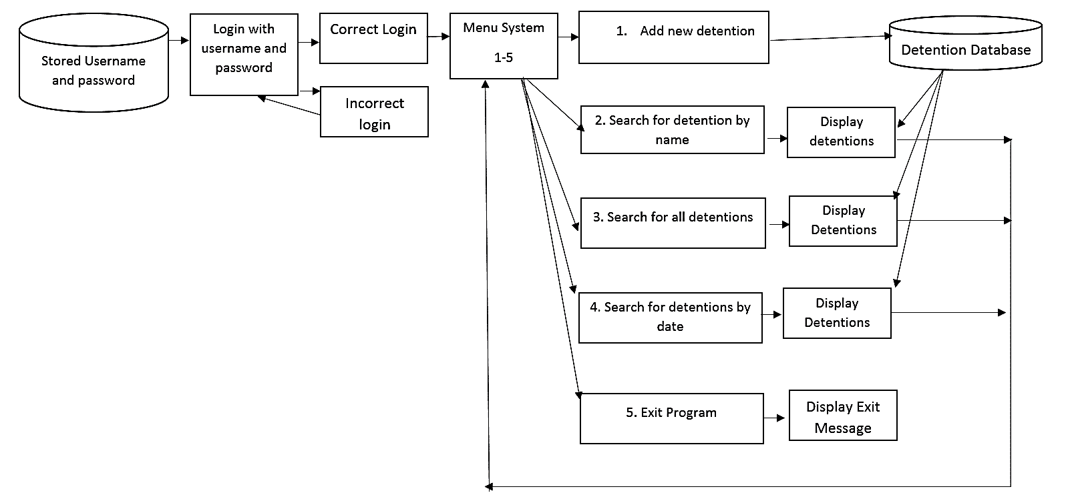
Structure Diagrams
This structure diagram was used in a school that wanted to create a detention database to store and search for information about detentions.

Slide 20
Pseudocode
Once you have a clear idea about what you want your algorithm to do and you understand how this can be implemented using algorithmic thinking.
The next step could be to write your algorithm in pseudocode (There are alternative methods, such as flowcharts).
Pseudocode is an algorithm, written in a language close to English and uses common programming terms, but it is designed to be understood by humans and not computers.

Slide 21
Pseudocode
Once a problem has been solved logically using pseudocode, it can then be coded using a programming language of your choice.
Pseudocode:
x=input(“What number do you want to find the square of?”)
y=x^2
print(x,”squared is”,y)
Python:

Slide 22
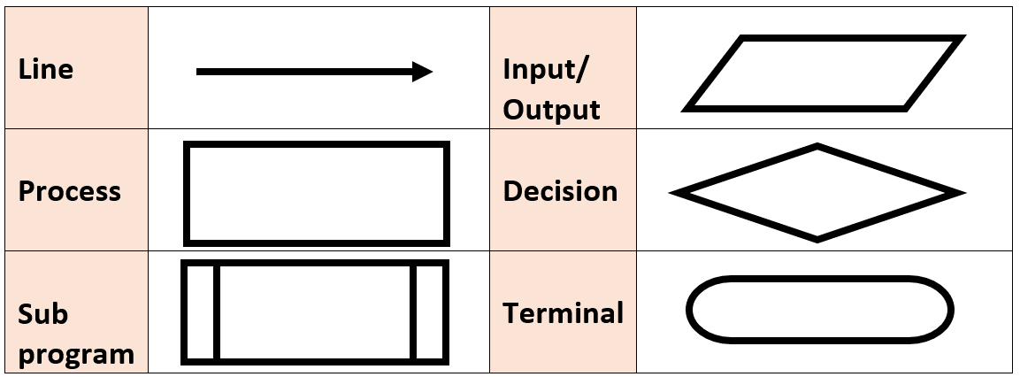
Flowcharts
As an alternative, or addition, to pseudocode, algorithms can also be written in the form of a flowchart using the following symbols.

Slide 23
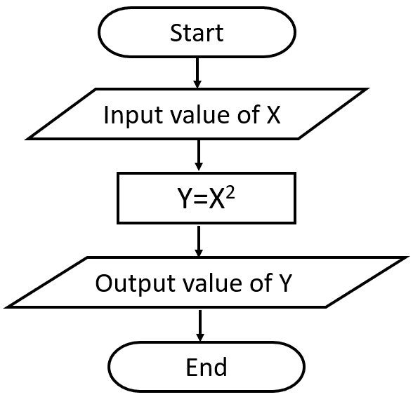
Flowchart Example

Slide 24
OCR Reference Language
OCR Exam Reference Language is a formally defined language.
All examination questions will be written in this language for clarity and consistency.
It is possible to write algorithms using reference language.
If you do this it may make it easier when it comes to interpreting exam questions. There are also many similarities between OCR reference language and the Python programming language – but they are NOT identical.

Slide 25
High Level Programming Language - Python
Pseudocode, flowcharts and the OCR reference language can be used to help understand a problem, but ultimately the program will need to be written using a programming language, so that it can be interpreted by a computer.
High level programming languages are used for this, as it enables a programmer to write programs in a language that is fairly close to English and is independent of a particular type of computer.
There are many programming languages to choose from, but in these presentations we will be using a high level programming language called Python.

Slide 26


Python Example
Python Program
Output when the program is run.

Slide 27
CHECKPOINT
What is a structure diagram?
What is pseudocode?
What is OCR Reference Language?
What is a flowchart
Give three examples of high level programming languages.

Slide 28
CHECKPOINT
1. What is a structure diagram? This is used to help understand what is required to solve a problem and includes decomposed sub-sections and how these are linked in relation to input, process and output.
2. What is pseudocode? This is an algorithm, written in a language close to English and uses common programming terms, but it is designed to be understood by humans and not computers.
3. What is OCR Reference Language? It is a formally defined language similar to pseudocode that OCR exam questions will be written in.
4. What is a flowchart? A flow chart is a diagrammatic representation of an algorithm.
5. Give three examples of high level programming languages. Python, Java, Ruby

Slide 29
Identify Common Errors
When you write an algorithm/computer program you may make an error.
There are two main types of error:
Syntax Errors
Logic Errors

Slide 30
Identify Common Errors
Syntax Errors
Syntax errors occur once you have written your program using a higher level programming language.
The programming language has many rules that you must follow. If you fail to follow the rules of the language then when you try to run the program you will get an error message.
For example in Python the word print must not have a capital P. If you write Print, instead of print, you will get an error message when you run the program.

Slide 31
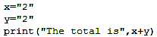
Identify Common Errors
Logic errors
These can occur in pseudocode, reference language and in flow charts. With this type of error the algorithm/program often works, but gives you an unexpected output.
For example, in this Python program, the program thinks that “2” is text rather than a number. When you run the program you get the output The total is 22, rather than The total is 4.

Slide 32

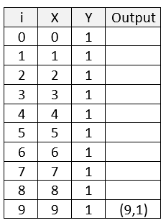
Trace Tables
One method of spotting a logic error is to use a trace table. The trace table can be used to trace the value of each variable as the program is being run.
In the program shown there are two variables x and y. Before we run the program x=0 and y=1. The next line of code is a for loop (we will look at these in more detail later on in the course).
This loop repeats x=x+y ten times. Each time it repeats it uses the new values for x and y.

Slide 33
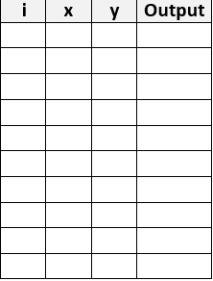

CHECKPOINT
Using an example, explain syntax error.
Using an example, explain logic error.
Create a trace table based on the program shown below:

Slide 34
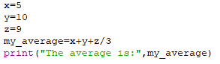
CHECKPOINT
Using an example, explain syntax error.
A syntax error is an error caused by not following the rules of the computer language you are using. E.g. If you write Input rather than input you will get a syntax error message.
2. Using an example, explain logic error.
A logic error is caused by creating an algorithm that produces output that is different from the output that you are expecting. The output from this program is 18 – which is not the average.

Slide 35
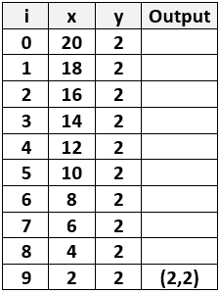
CHECKPOINT
3. Create a trace table based on the program shown below:

Slide 36

What is the difference between Searching and Sorting?
Searching
Looking through a list of items until you finding the item you are looking for.
Sorting
Moving items in a list so that they are in a particular order. E.g. alphabetical order or numerical order.

Slide 37
Searching Algorithms: Linear Search
A linear search is a very simple search algorithm. It starts at the beginning of a list of items and moves through the items, sequentially, until it finds the item it is looking or reaches the end of the list without finding the item it is looking for.
The advantages of this type of search:
It is simple to code
The list doesn’t need to be sorted before you start the search.
Joe | Boris | Cassie | Kate | Zahra | Callum | Zoe | Paul | Gaza

Slide 38
Searching Algorithms: Linear Search
The disadvantages of this type of search:
The longer the list, the slower this method usually is.
For example:
if you were searching for a UK Citizen and the list you were searching contained the name of every UK citizen, it might take a very long time before you were able to find a match. Of course, if the person you were looking for was near the beginning of the list, it would be a quick search but this is unlikely.

Slide 39
Linear Search Algorithm
Which item are you searching for?
Start at the first item in the list
Does it match the item you are searching for?
If the answer is YES then stop or if the answer is NO then move to the next item.
Repeat steps 3 and 4 until then end of the list is reached.
Joe | Boris | Cassie | Kate | Zahra | Callum | Zoe | Paul | Gaza

Slide 40
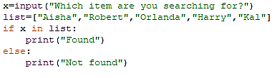
Linear Search Algorithm in Python

Slide 41


Searching Algorithms: Binary Search
The binary search algorithm can only be used on a list that has already been sorted, but if this is the case it is usually a lot faster than the linear search algorithm.
Unsorted List
Joe | Boris | Cassie | Kate | Zahra | Callum | Zoe | Paul | Gaza
Sorted List
Boris | Callum | Cassie | Gaza | Joe | Kate | Paul | Zahra | Zoe

Slide 42
Searching Algorithms: Binary Search
Which item are you searching for?
Select the middle item in the list
Compare the item you are search for with this item. If this item is equal to the item you are searching for then stop.
If the item you are searching for is lower than the middle item in the list, then repeat 2-4 with the left-hand side of the list; If the item you are searching for is higher than the middle item in the list, then repeat 2-4 with the right-hand side of the list.

Slide 43
Binary Search Example
Which item are you searching for? Kate
Select the middle item in the list. If this equals Kate then stop.
Boris | Callum | Cassie | Gaza | Joe | Kate | Paul | Zahra | Zoe
If the middle item (Joe) is lower than the search item (Kate) then split the list and remove the left hand half.
If the middle item (Joe) is higher than the search item (Kate) then split the list and remove the right hand half.

Slide 44
Binary Search Example
Select the middle item in the list (if the list is an even number choose the item to the left - Paul). If this equals Kate then stop.
Kate | Paul | Zahra | Zoe
If the middle item (Paul) is lower than the search item (Kate) then split the list and remove the left hand half.
If the middle item (Paul) is higher than the search item (Kate) then split the list and remove the right hand half.

Slide 45
Binary Search Example
Select the middle item in the list (if the list is an even number choose the item to the left). If this equals Kate then stop.
Kate

Slide 46
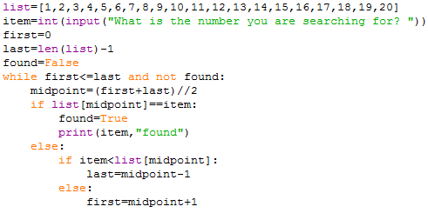
Binary Search Algorithm in Python

Slide 47
Linear Search V Binary Search
A sorted list of 100 numbers .
Linear Search
Best case – The number you are looking for is the first number in the list.
Number of searches:1
Worst Case - The number you are looking for is the last number in the list.
Number of searches:100
Binary Search
Best case - The number you are looking for is the middle number in the list.
Number of searches:1
Worst case – The number would be located at the median of the last possible division.
Number of searches: 7

Slide 48
CHECKPOINT
What is the difference between searching and sorting?
What is a linear search?
What is a binary search?

Slide 49
CHECKPOINT
What is the difference between searching and sorting? Searching is looking through a list of items until you finding the item you are looking for. Sorting is moving items in a list so that they are in a particular order.
What is a linear search? Starting at the first item and then moving to the next item until you find the item you are looking for.
What is a binary search? This involves continually splitting a list into two lists and identifying which side of the list the item is found on. You can then discard the items in the other half of the list.

Slide 50
Sorting Algorithms
There are lots of algorithms that can be used to sort data. This course requires that you understand three sorting algorithms:
Bubble Sort – This is used to sort a list by comparing items that are next to each other.
Merge Sort – This is used to sort a list by repeatedly dividing the list into two smaller lists until the size of each list becomes one. The process is then reversed, but this time the lists are reordered.
Insertion Sort - This is used to sort a list by looking at each item in turn and inserting the item into its correct position in the list.

Slide 51
Bubble Sort Algorithm
Start at the first item in the list.
Compare this item with the item to its right.
If this item is smaller than the item to its right then leave them; if not, swap them.
Move to the next item in the list
Repeat 2 - 4 until you reach the end of the list
Go through the list of values for a second time, a third time and so on, repeating steps 1- 5 until there are no more swaps to be made.

Slide 52
Bubble Sort Example
Start at the first item in the list.
3
1
2
5

Slide 53
Bubble Sort Example
Compare this item with the item to its right.
3
1
2
5

Slide 54
Bubble Sort Example
If this item is smaller than the item to its right leave them;
if not, swap them.
3
1
2
5

Slide 55
Bubble Sort Example
Move to the next item in the list
Compare this item with the item to its right.
If this item is smaller than the next item leave them; if not, swap them.
1
3
2
5

Slide 56
Bubble Sort Example
Move to the next item in the list
Compare this item with the item to its right.
If this item is smaller than the item to its right leave them; if not, swap them.
1
2
3
5

Slide 57
Bubble Sort
In this case the list has been sorted. For longer lists you would need to go through the list of values for a second time, a third time and so on, you would repeat this until there were no more swaps to be made.
1
2
3
5

Slide 58
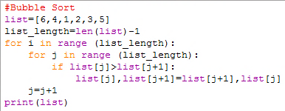
Bubble Sort Program in Python

Slide 59
Merge Sort
The Merge Sort algorithm is used to sort a list by first dividing the list in half and then dividing each of these list in half and then dividing each of these lists in half. This continues until the size of each list becomes one.
This process is then reversed with items merged into longer and longer lists, but as they are merged the items are put in the correct order.
This is sometimes called the Divide and Conquer algorithm.

Slide 60
Merge Sort Algorithm
1. If there is only one item in the list then stop.
2. Divide the list into two parts.
3. Repeat step 2 until there is only one item in each list.
4. Merge one list with another list and place the items in the new merged list in the correct order.
5. Repeat step 4 until all of the lists have been merged together into a single list.

Slide 61
Merge Sort Example
You have been asked to sort the following list into ascending order: 59328417
First divide the list into two lists
5
9
3
2
8
4
1
7
5
9
3
2
8
4
1
7

Slide 62
Merge Sort Example
Now divide these lists again.
5
9
3
2
8
4
1
7
5
9
3
2
8
4
1
7
5
9
3
2
8
4
1
7
Divide them again until each item is in a list of one.

Slide 63
Merge Sort Example
Now merge the individual items into lists of two items. Put these items in the correct order.
5
9
3
2
8
4
1
7
5
9
2
3
4
8
1
7

Slide 64
Merge Sort Example
Now merge the items again. Put these items in the correct order. Repeat this process until you have a single list.
5
9
2
3
4
8
1
7
2
3
5
9
1
4
7
8
1
2
3
4
5
7
8
9

Slide 65
Merge Sort Example
Now merge the individual items into lists of two items. Put these items in the correct order.
5
9
3
2
8
4
1
7
5
9
3
2
8
4
1
7
5
9
3
2
8
4
1
7
Divide them again until each item is in a list of one.

Slide 66
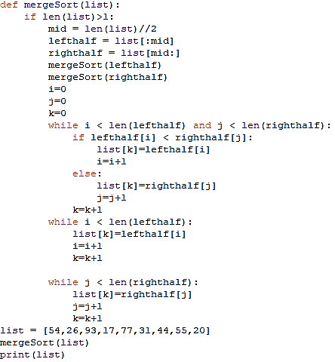
Merge Sort Algorithm in Python

Slide 67
Insertion Sort
The Insertion Sort algorithm is used to sort a list by looking at each item in turn and inserting this item in the correct position in the list.
It does this by performing a comparison with the item to its left and continues doing this until it arrives at its correct position in the list.

Slide 68
Insertion Sort
1. Start with the second item in the list and compare this item with the first item in the list.
2. If second item in the list is larger than the first item in the list then leave them in their positions, but if the second item is smaller then swap the two numbers.
3. Now examine the third number in the list. If the third item is smaller than the second item in the list, then compare it with the first item on the list. If it is smaller than the first item in the list, insert it in this location by moving the first two numbers along.
4. Repeat this process by comparing each number with the numbers to its left until a smaller number is found. When it is, then insert the number in the correct position and move the other numbers along.

Slide 69
Insertion sort example
You have been asked to sort the following list into ascending order: 59328417
Start with the second item in the list and compare this item with the first item in the list.
If the second item in the list is larger than the first item in the list then leave them in their positions, but if the second item is smaller then swap the two numbers.
5
9
3
2
8
4
1
7
5
9
3
2
8
4
1
7

Slide 70
Insertion sort example
Now examine the third number in the list. If the third item is smaller than the second item in the list, then compare it with the first item on the list. If it is smaller than the first item in the list, insert it in this location by moving the first two numbers along.
5
9
3
2
8
4
1
7
3
5
9
2
8
4
1
7

Slide 71
Insertion sort example
Now examine the forth number in the list. Compare this number with the number to its left until a smaller number is found or no smaller number is found. i.e. compare it with 9 (2 is smaller than 9) and then 5 (2 is smaller than 5) and then 3 (2 is smaller than 3) then insert the number in the correct position by moving the other numbers along.
3
5
9
2
8
4
1
7
2
3
5
9
8
4
1
7

Slide 72
Insertion sort example
Now examine the fifth number in the list. Compare this number with the number to its left until a smaller number is found or no smaller number is found. i.e. compare it with 9 (8 is smaller than 9) and then 5 (8 is not smaller than 5) then insert the number in the correct position by moving the other numbers along.
2
3
5
9
8
4
1
7
2
3
5
8
9
4
1
7

Slide 73
Insertion sort example
Now examine the sixth number in the list. Compare this number with the number to its left until a smaller number is found or no smaller number is found. i.e. compare it with 9 (4 is smaller than 9) and then 8 (4 is smaller than 8) etc. then insert the number in the correct position by moving the other numbers along.
2
3
5
8
9
4
1
7
2
3
4
5
8
9
1
7

Slide 74
Insertion sort example
Now examine the seventh number in the list. Compare this number with the number to its left until a smaller number is found or no smaller number is found. i.e. compare it with 9 (1 is smaller than 9) and then 8 (1 is smaller than 8) etc. then insert the number in the correct position by moving the other numbers along.
2
3
4
5
8
9
1
7
1
2
3
4
5
8
9
7

Slide 75
Insertion sort example
Now examine the last number in the list. Compare this number with the number to its left until a smaller number is found or no smaller number is found. i.e. compare it with 9 (7 is smaller than 9) and then 8 (7 is smaller than 8) etc. then insert the number in the correct position by moving the other numbers along. The list is now in ascending order
1
2
3
4
5
8
9
7
1
2
3
4
5
7
8
9

Slide 76
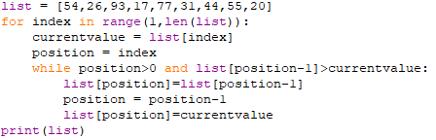
Insertion Sort Algorithm in Python

Slide 77
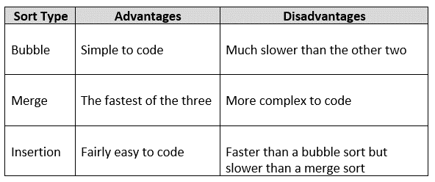
Advantages and Disadvantages of Each Sort

Slide 78
CHECKPOINT
1. Describe the main features of each of the sort algorithms shown below:
Bubble Sort
Merge Sort
Insertion Sort

Slide 79
CHECKPOINT
1. Describe the main features of each of the sort algorithms shown below:
Bubble Sort - This is used to sort a list by comparing items that are next to each other.
Merge Sort - This is used to sort a list by repeatedly dividing the list into two smaller lists until the size of each list becomes one. The process is then reversed, but this time the lists are reordered.
Insertion Sort - This is used to sort a list by looking at each item in turn and inserting the item into its correct position in the list.

Slide 80
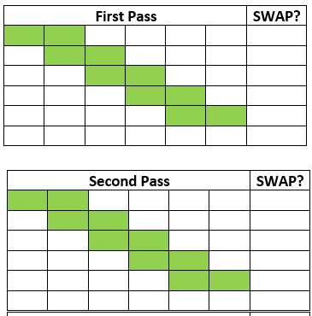
CHECKPOINT
Complete this BUBBLE sort. 6,8,23,1,43,17,5,10. You will need 3 passes

Slide 81
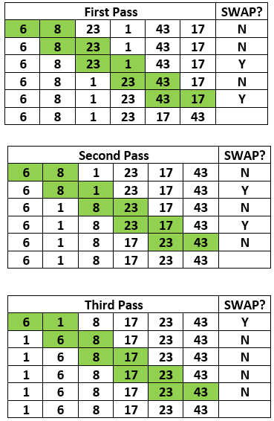
CHECKPOINT
Complete this BUBBLE sort. 6,8,23,1,43,17

Slide 82
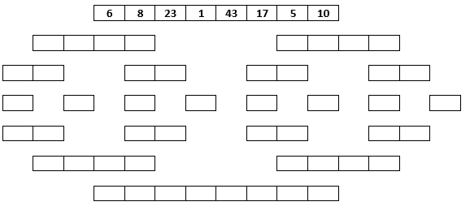
CHECKPOINT
Complete this MERGE sort.

Slide 83
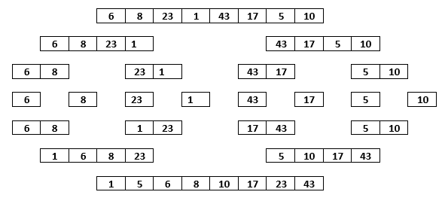
CHECKPOINT
Complete this MERGE sort.

Slide 84
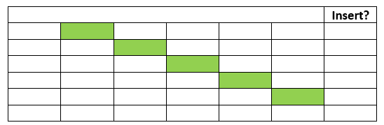
CHECKPOINT
Complete this INSERTION sort. 6,8,23,1,43,17

Slide 85
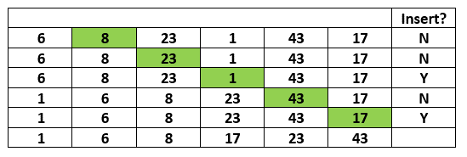
CHECKPOINT
Complete this INSERTION sort. 6,8,23,1,43,17

Slide 86
What have we learnt in Unit 2.1?

